Slide 1
Week 03, Day 04
Loops and Array Challenges
CodeSLO, LLC 2018

Slide 2
For Loops

Slide 3
For Loops
One thing that computers are very good at is repeating a series of instructions accurately at almost unthinkable speeds.
As programmers, one of the ways we use this functionality is via loops.
One of the basic types of loops is the for loop.
Let’s write one.

Slide 4
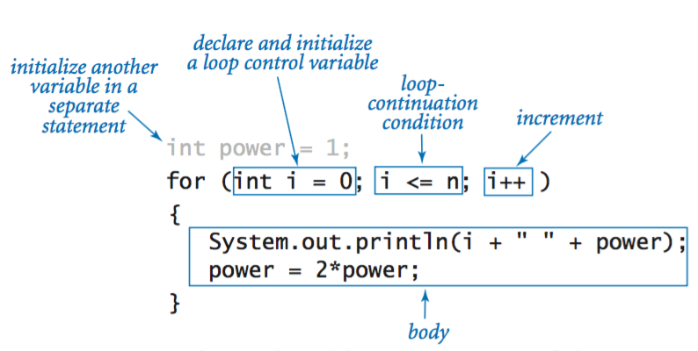
Anatomy of a For Loop

Slide 5
For Loop Example
// a loop that counts to twenty in the console
for(let i = 1; i<=20; i++){
console.log(i);
}

Slide 6
To infinity… and beyond!
One thing to watch out for with any kind of loop is the accidental creation of an infinite loop.
A loop must always have an achievable exit condition.
// running this code will crash the environment
for(let i = 0; i < 10; i--){ // do you see the problem?
console.log(i);
}

Slide 7
Time to check in!

Slide 8
Exercise: Count by twos
Create a for loop that logs all the even numbers between 2 and 100 to the console.
Use the modulo (remainder) operator to test for even values.

Slide 9
Descending For Loops
Creating a descending for loop is just a different way of using a for loop. Instead of counting up, you count down.
// counts down from 20 to 0
for(let i = 20; i >= 0; i--){ // note the i--. i++ would give us an infinite loop!
console.log(i);
}

Slide 10
Iteration
Probably the most common use of the for loop is to iterate through arrays.
let myArr = ['JavaScript','is','awesome','!!!'];
// a for loop that iterates through myArr and logs each element
for (let i = 0; i < myArr.length; i++){
console.log(myArr[i]);
}

Slide 11
Breaking a loop
You can use if statements in a loop to check a conditional everytime the loop runs.
You can break out of a loop using either the break or return statement.

Slide 12
Break example
// this loop will only run until it finds an odd number
function countTillOdd(arr){
for(let i = 0; i<arr.length-1; i++){
if(arr[i] % 2 !== 0){
console.log('I found an odd. I\'m freaking out! I quit!');
break;
}
console.log(arr[i]);
}
}
let testArr = [2,4,6,8,10,11,12,14,16,18];
countTillOdd(testArr);

Slide 13
Exercise: onlyOdds
Create a new file called onlyOdds.js
In onlyOdds, create an empty array called result
Using a for loop, push all the odd numbers between 1 - 1000 into the result array.
Log the result array.
Log the length property of the result array.
Log an array made up of all the elements in the result array with a value between 30 and 70.
Log an array made up of the last ten elements of the result array

Slide 14
Array Challenges

Slide 15
Array.indexOf
Often, it is useful to know if an array contains a certain element.
We can do this programmatically with the Array.indexOf method.
Array.indexOf will return one of two values. Either it will return the first index position of a matching element, or it will return -1, which means it did not find a match.

Slide 16
Array.indexOf example
let arr = [1,2,3,4,5,6];
let value = 3;
let pos = arr.indexOf(value);
console.log(pos);

Slide 17
Exercise: Got apples
Find the file gotApples.js in today’s source code.
Create a function that uses if/else and Array.indexOf to answer either question.

Slide 18
Basic Array Challenges
We’ve added some basic array challenges for you in Codepen.
Let’s check them out and complete them as a class.
https://codepen.io/codeslo/collections

Slide 19
Break! Back in Five...

Slide 20
Fullstack Array01 Challenges
Everyone ready for some array challenges?
Our next batch of Fullstack Academy coding challenges will test your ability to work with arrays.
This batch is a little harder than the last one we worked through. You know all the code necessary to complete each problem.
However, some of those problems contain details that might confuse you or trip you up. Try to envision how the code runs, and try to think logically and procedurally through each problem.

Slide 21
Pseudo code
Pseudo code isn’t really working code.
It’s a way to think about solving a complex problem.
Some people like to do this on a whiteboard or on a sheet of scratch paper.
Another way you can do it is simply to outline a function using comments in your coding environment.
Let’s look at one of today’s problems and use pseudo code to come up with a strategy for solving it.

Slide 22
Fullstack Challenges (cont)
Feel free to work on your solutions in VS Code if you find that helpful to do.
We’ll be looking at the myLastIndexOf challenge together, using pseudo code. The actual code is going to be up to you.
Find today’s challenges right here:
https://codepen.io/collection/DwdaQV/

Slide 23
Exercise: Complete All Array01 Challenges
Good luck!

Slide 24
Questions?

Slide 25
Never Leave a Challenge Unfinished
It’s important that all of complete ALL of the Fullstack Academy coding challenges.
Today is the last week of week three. The end of next week marks the halfway point for this course.
You have three days coming up. Try to make sure that you’ve got all of the challenges from yesterday and today complete by the end of the weekend.
Why? Because we’ve got a new batch of challenges on Monday!
This is the steepest part of the learning curve. It’s important to work hard, stay focused, and use the resources you have to get help.

Slide 26
Code on!

